Slide 1
Requirement Engineering

Slide 2
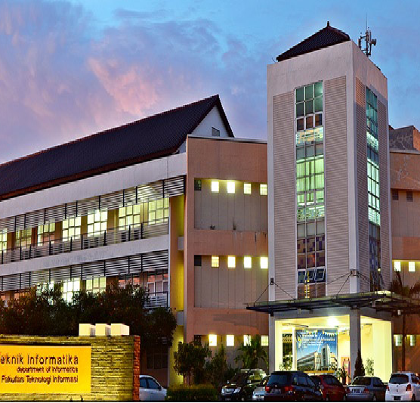
RE Process
Requirement Engineering
Ratih NE Anggraini, Ph.D

Slide 3
Outlines
The Role of Requirement Analyst
Requirement Engineering Process

Slide 4

The Role of Requirement Analyst

Slide 5

Who is Requirement Analyst?

Slide 6
Requirement Analyst
Requirement Analyst (RA) is responsible for determining project requirements, acting as a liaison for managers, stakeholders and the development team

Slide 7
The Role of Requirement Analyst
Determine the actual requirements of a system with customers, users and developers
Manage the mechanism for changing requirements with users and customers
Pay attention to new technology
Facilitate reuse of project artifacts
Provide input regarding methods, techniques, and tools for the project
Use metrics to measure, track and control requirements
Facilitate discussions and mediate conflicts
Study the domain area of the project being worked on

Slide 8
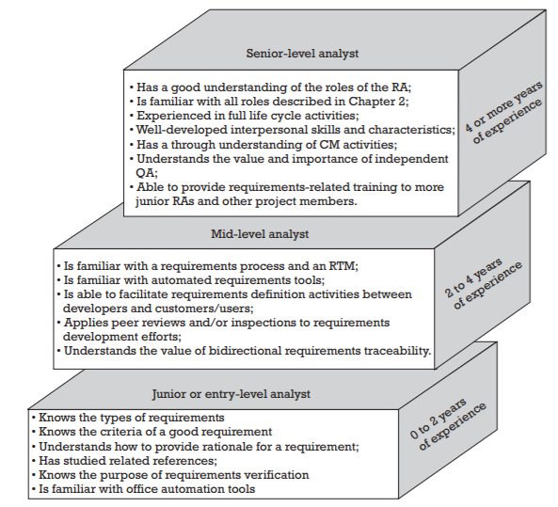
Skills needed by RA

Slide 9
A good RA characteristics
Willing to continue to learn and apply it effectively
Good listener, communicator and writer
Have good negotiation skills
Proactive
Have the ability to communicate effectively with management
Have a focus
Able to invite out-of-the-box thinking
Set achievable goals and achieve them
Contribute to the risk process

Slide 10

RE Process

Slide 11
What is ...
PROCESS ???

Slide 12
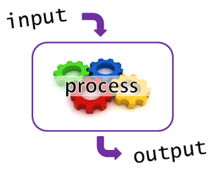
Garbage in garbage out
It is important to collect correct requirements

Slide 13

Why do we need RE?
IF SW is only an automation process, what will happen to ...
It is more important to understand the problem than the solution. [Albert Einstein]

Slide 14
RE Process
The requirement's engineering process is carried out to find, analyze, document and validate system requirements

Slide 15
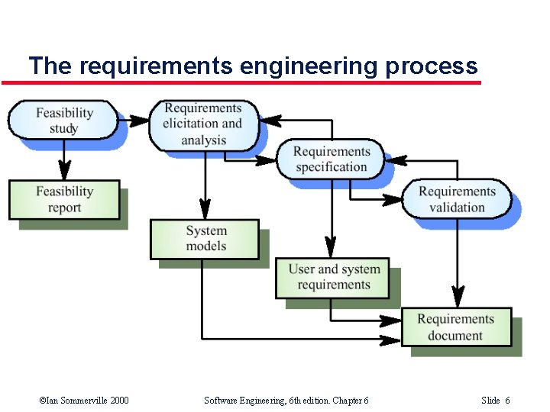
Proses RE

Slide 16
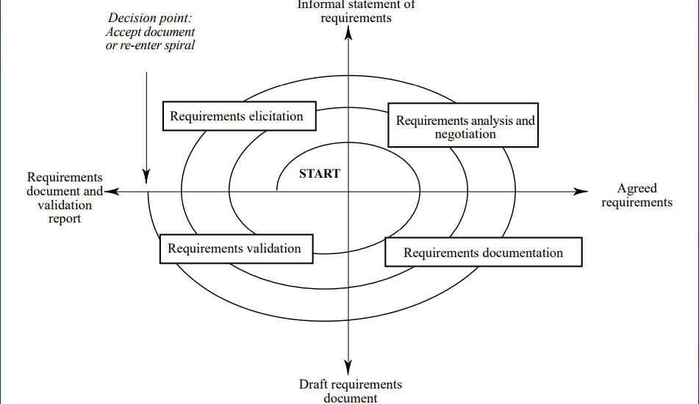
RE Process (Spiral)

Slide 17
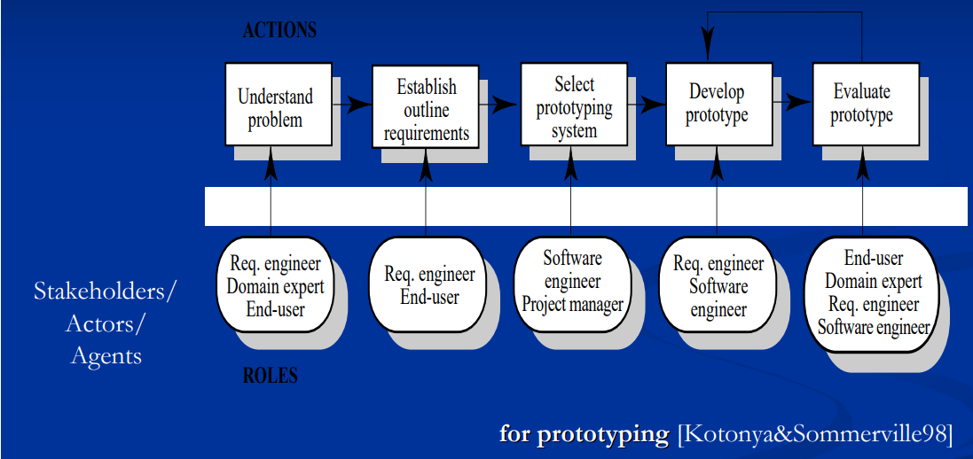
RE Process (RAD)

Slide 18
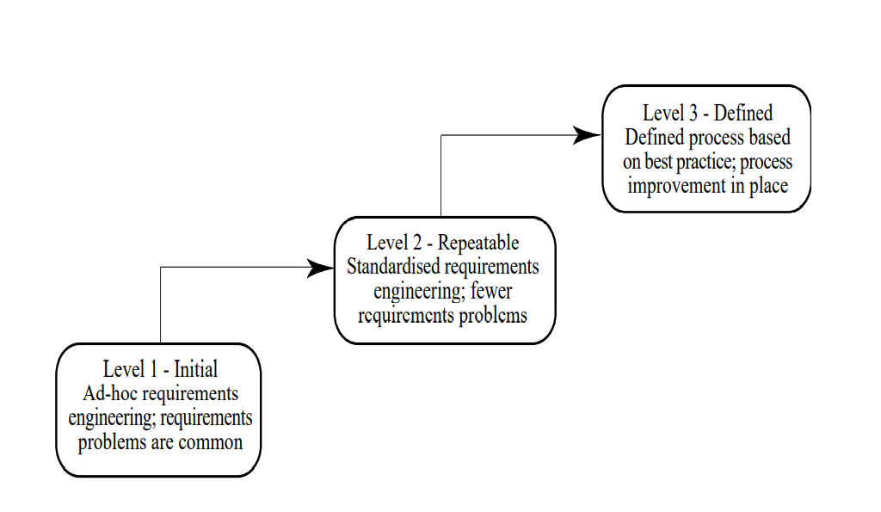
RE Process Maturity Model

Slide 19
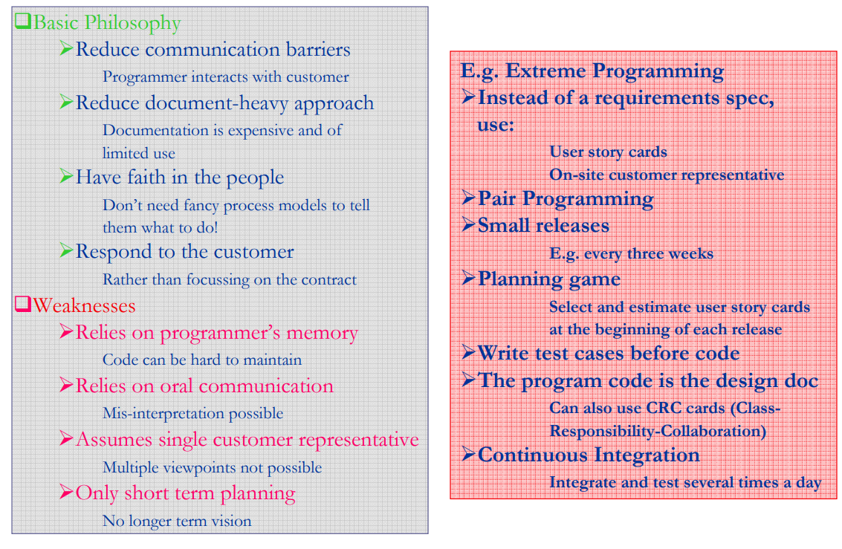
RE Process in Agile

Slide 20
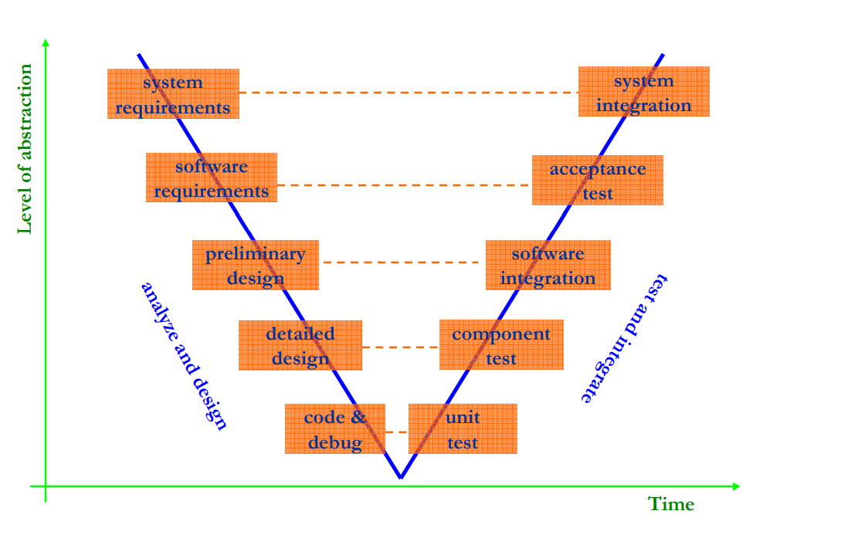
RE Process in V Model

Slide 21
Feasibility Study
At this stage it is decided whether the proposed system is feasible to be developed or not
Some considerations:
Does the system contribute to the achievement of organizational goals
Can the system be developed with the available technology and budget?
Can the system be integrated with other existing systems?

Slide 22
Feasibility study implementation
Conducted based on assessment and collection of information and reports
Questions that can be asked of people in the organization
What if the system is not implemented?
What problems exist with the current process?
How can the proposed system help?
Does it require new technology?
Will there be legal problems?
How are the risks related to cost and schedule?
What are the advantages/disadvantages?

Slide 23
Feasibility Study Types
Technological feasibility
Performed to ensure that the organization has the software, hardware, personnel and expertise to complete the project
Economic analysis
Also called cost/benefit analysis, a procedure to ensure that the benefits are worth the costs
Can be done with a cost-based study or time-based study
Legal feasibility
Ensure that the system built does not conflict with applicable law

Slide 24
Feasibility Study Types (2)
Operational Feasibility
The operational feasibility study measures how well the proposed system can solve problems
Schedule Feasibility
A system will not be useful if it takes too long to complete
This process measures how reasonable the schedule is. It must be assessed whether the deadline is mandatory or just a wish
Financial Feasibility
Measure project costs, sponsorship, cash flow and profits

Slide 25
Requirement Elicitation and Analysis
This process involves customers.
The goal is to understand application domains, services and system operational boundaries
Moreover, it can also involve other stakeholders such as users, managers, experts, etc

Slide 26
Requirement Specification
At this stage, a requirements document that clearly describes system requirements is created
These requirements are written in a document called Software Requirements Specification (SRS)

Slide 27
Requirement Validation
Requirements validation is carried out to ensure that system requirements and SRS are according to what the client and system needs
Some techniques:
Requirement review, inspection dan walkthrough
Prototyping

Slide 28
Assignment
Do feasibility study on your proposed topic.
Assumptions: sponsors provide 10 million in funding and 10 weeks of development time
Report format:
Executive summary / Abstract
Introduction → System description
Feasibility study and solution
Conclusion

Slide 29
THANK YOU

